Slide 1
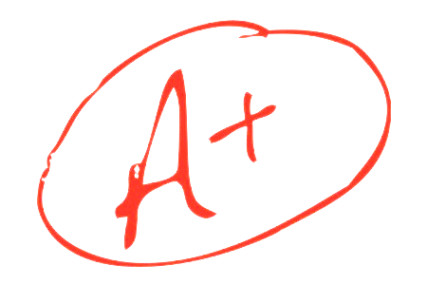
Prediction Challenge #2
Vraj Desai

Slide 2
Predictions
Intuition
Score of exams matter considerably more than participation
Asking questions and leaving early are harder parts of the grader to assume
No patterns were found to show students that left early or never did achieved a certain set of scores
Scores >80 led to A’s even with 0 participation
Thus, participation isn’t as a big deal as it seems
Nonetheless, the machine did the heavy lifting as we were using its computing and algorithm to come up with the lowest amount of error

Slide 3
Tree

Slide 4
Findings
Grade mainly involves a combination of Scores and Participation
Discovered that Scores are heavily weighted in comparison to Participation
Tree Understandings
Followed condition rules to find that scores above 73 were generally A’s and asking questions was somewhat important. Overall, scores are the most important by far
This was very similar to when I manually predicted by trial & error last week so knew this would prove to be a success

Slide 5
Conclusion
Created various tree and picked the one that was similar to last week’s class
Used intuition to realize that number values will affect Grade the most
Even though question and going to class are important, there was no significant correlation of the two that affected a grade in 1 direction
In all, grades will be a function of both scores on exams and participation
Scores will be more heavily emphasized as some students will not choose to participation if they already know the material
Obviously, participation helps….but not to a great extent

